Slide 1
Automation for Good… and CHAOS
Will you help or hinder?

Slide 2
Attention
MMS sessions are 60-75 minutes followed by LONG Q&A
Please hold detailed questions until that Q&A starts
Feel free to ask clarification questions
Remind the speakers to use Zoom It when you can’t see

Slide 3



Donnie Taylor
Scott Corio
MVP – Azure & PowerShell
Azure MVP, Chisel Noob
donnietaylor
in/donnietaylor
dumpsterdave
in/scottcorio

Slide 4
Automation Is Power
It doesn't care what you build with it
Same trigger, same webhook, same AI node...
...could warn a community about a wildfire OR file a passive-aggressive GitHub issue
The code is the same. The intent is on you.
Tonight we explore both. No judgment. (Okay, a little judgment.)

Slide 5
The n8n Building Blocks
Triggers — Webhook, Schedule, Event, or "someone did something dumb on GitHub"
Logic Nodes — IF, Switch, Merge, Loop, "keep escalating until someone cries"
AI Nodes — LLM calls, prompt chaining, structured output, righteous indignation
Actions — Email, Slack, GitHub API, spreadsheets, bureaucratic suffering

Slide 6
Tonight's Menu
For Good
Simple Code Formatter
Take the intern out of the codebase
Community Risk Radar
Weather, FEMA, wildfire alerts
Daily IT Handoff
Email, Jira, GitHub — summarized
Civic Data Brief
Stay informed of your local government goings-on
Patch Tuesday for NonProfits
Stop the tech jargon when dealing with normal people
For Chaos
GitHub Snark Bot
Someone's afternoon is about to get worse
Someone else’s is about to get yummy
HOA Asshole Engine
Your grass is 0.3" too tall
IT Bureaucracy Machine
Password reset? That'll be 3 meetings.

Slide 7
Simple Code Formatter
Emojis never ever ever ever ever ever ever ever belong in code

Slide 8
AI Code Formatter
PowerShell, JavaScript & TypeScript — One script, multiple languages
AI-powered formatting — Calls OpenAI to apply best practices & style guides
Diff preview before applying — See every change in red/green before you commit
Dry-run & auto-backup — Safe by default; .bak files unless you opt out
Recursive directory mode — Point it at a folder, walk the whole tree

Slide 9
Community Risk Radar
Because your neighborhood deserves better than a Facebook post

Slide 10
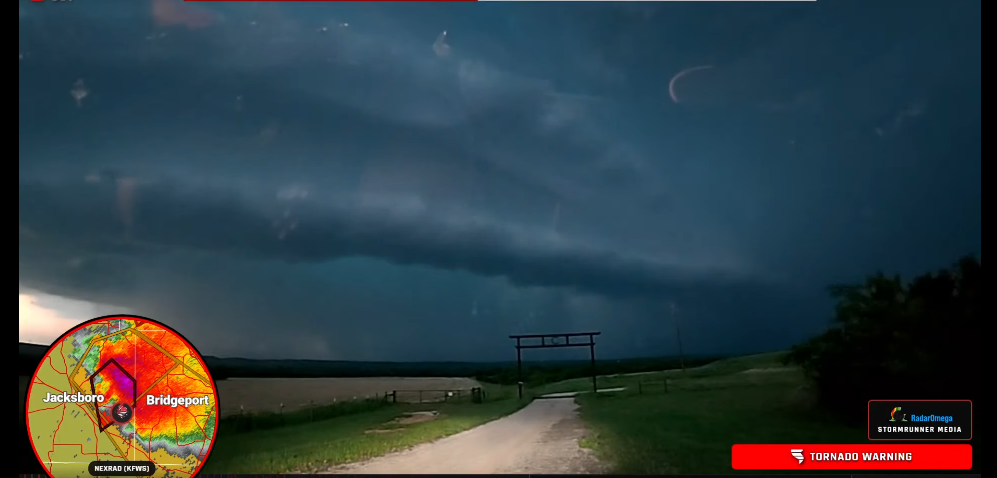

Slide 11
What It Watches
NWS Weather Alerts — Severe storms, tornadoes, frost events
USGS Flood Monitoring — River gauge levels, flood watches
Wildfire Alerts — Active incidents, perimeter updates
FEMA Declarations — Federal disaster declarations by county
Notifies your community via text, email, or Slack — No doomscrolling required

Slide 12
Daily IT Handoff
The morning standup you never have to actually have again

Slide 13
Daily IT Handoff
Email — Unresolved threads, anything marked urgent (or yelled in caps)
GitHub Issues — Open PRs, stale issues, things that "should be a quick fix"
Jira Tasks — What's overdue, blocked, or "In Progress" since February
AI Summary — "Here's what actually matters today. You're welcome."

Slide 14
Civic Briefer
You have never in your life attended your local council. You should.

Slide 15
Civic Briefing Bot
Legistar API — Pulls 90 days of Dallas City Council actions
Parse & Categorize — Counts by type, status, flags what actually passed
AI Briefing — GPT writes a plain-English summary for nonprofits & residents
Outlook Delivery — Hits your inbox with an Engagement Level: HIGH/MODERATE/ROUTINE

Slide 16
Patch Tuesday for Normal People
Working with non-IT people can be exhausting…..for them.

Slide 17
Lost in Translation: Patch Tuesday Edition
WHAT IT READS
WHAT THE DIRECTOR HEARS
CVE-2025-21311: Unauthenticated RCE in HTTP.sys, CVSS 9.8, exploited in the wild. Patch immediately on all Windows Server 2022/2025 hosts.
“Something about a server. He said ‘HTTP’ twice and his eye started twitching.”
Out-of-band patch supersedes KB5034441; reboot required, BitLocker recovery key prompt expected on UEFI fleet.
“He used the words ‘out of band’ and now nobody can log in. Should I be worried?”
Mitigations available via registry workaround pending vendor hotfix; lateral movement via NTLM relay confirmed.
“He wants to edit the registry. Is that the thing the auditors said never to touch?”
13 Critical, 47 Important. One zero-day in Exchange. Defer non-essential patches to next maintenance window.
“He sighed. He hasn't sighed like that since the printer thing. We’re definitely doomed.”
WHAT THE BOT SENDS: “Patch your Windows servers this week. One thing is being actively attacked. Everything else can wait. Priority: HIGH.”

Slide 18
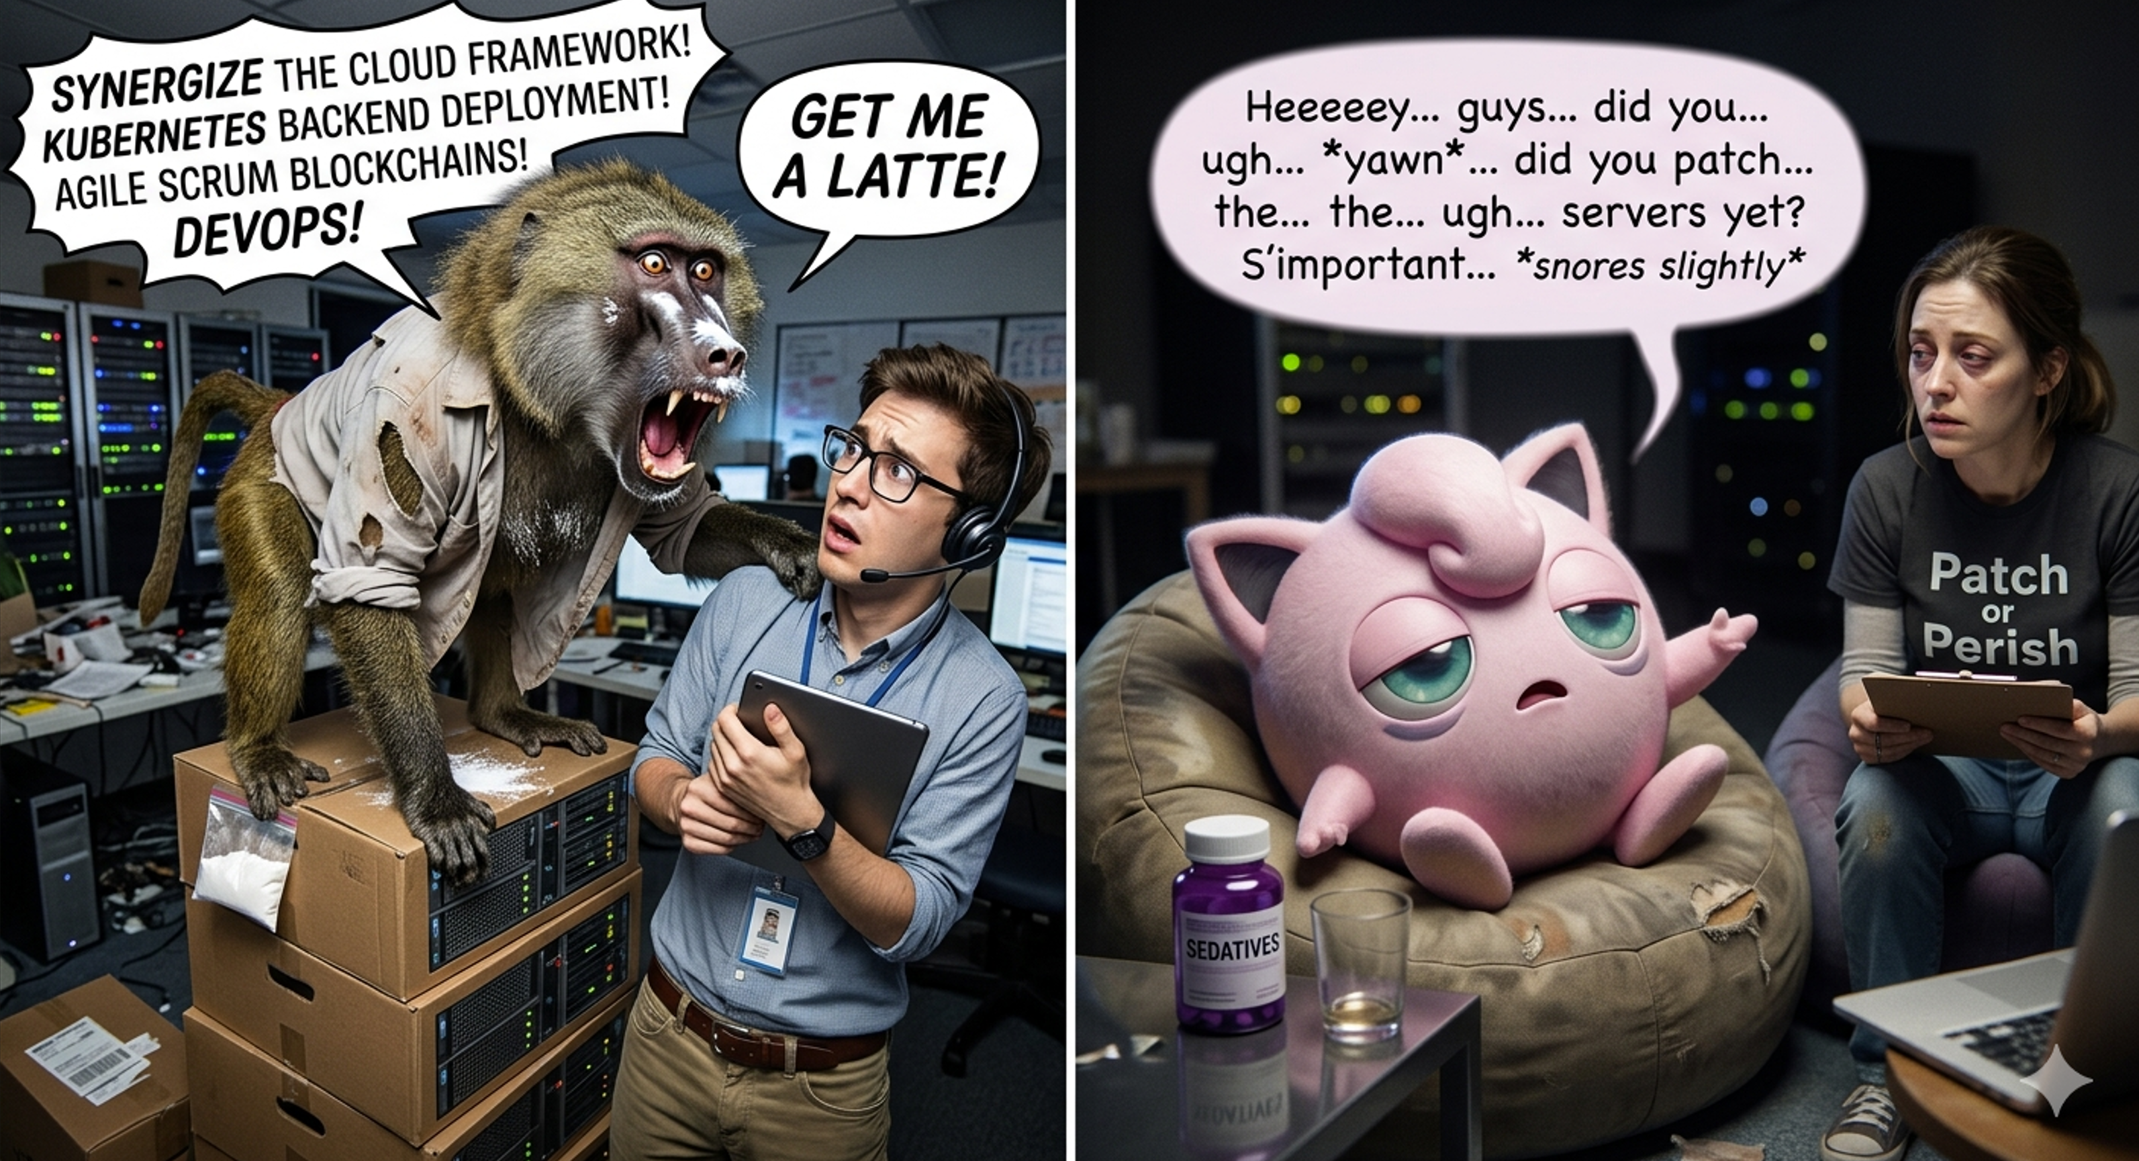

Slide 19
Patch Tuesday Bot
MSRC API — Pulls the latest Patch Tuesday CVRF document from Microsoft
Parse & Prioritize — Counts criticals, flags zero-days exploited in the wild
AI Briefing — GPT writes plain English: “patch now” vs. “this can wait”
Outlook Delivery — Hits your inbox with a Priority Level: CRITICAL/HIGH/MODERATE/ROUTINE

Slide 20
The "Good" Pattern
Real-world signal → Aggregate → Summarize with AI → Notify humans
Schedule or webhook triggers the workflow
HTTP nodes poll multiple public APIs in parallel
IF nodes filter noise — only act on real alerts
LLM node summarizes and writes the human-readable message
Email/Slack/SMS node delivers it

Slide 21
Automation for Chaos
Same techniques. Significantly worse intentions. Zero regrets.

Slide 22
Simple Code F@#$@
Emojis never ever ever ever ever ever ever ever belong in code

Slide 23
Emoji Chaos Bot
Read Code — Slurps your beautifully formatted .ps1, .js, or .ts
Summon GPT — Asks the AI to ruin it: cursed comments, emojis, RaNdOm CaSe
Validate — Parser confirms the chaos still runs (we're vandals, not monsters)
Apply Damage — Saves the abomination, keeps a .bak so you can undo your mistake

Slide 24
GIT(hub) Outta Here
Something hype-worthy is about to happen...

Slide 25
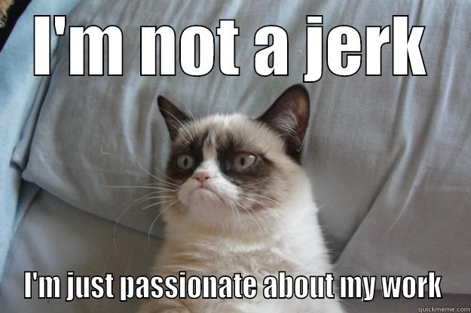
How It Works
Fetches all public repos for a given GitHub username via API
AI reviews each repo — README, commit history, general vibes
Generates snarky, passive-aggressive GitHub issues against their code
Files them automatically.
This README has less documentation than a sticky note.
Bold choice.

Slide 26
[ MMSMOA GITHUB TARGET SYSTEM v2.0 ]
INITIATING TARGET SCAN...
> FUEL SOURCE............: Coffee (critical dependency) > TECHNICAL CERTS .......: Microsoft MVP
> PRIMARY LANGUAGE.......: PowerShell
> LAST GIST..............: Remove-AzArcAgent.ps1
> SPECIALIZATION.........: Intune / Endpoint / Azure Arc > QUIRKS.................: Word Processing: 50Hz, Word Output: 200Hz
> GITHUB HANDLE..........: ████████████
> TARGET IDENTIFIED
@AllwaysHyPe

Slide 27
GitHub Snark Bot

Slide 28
H.O.A-HOLE

Slide 29
The Workflow
Input: a street address
Fetches Google Street View images of the property
Searches for HOA CC&R guidelines for that address
AI cross-references images vs. rules and suggests violations
Outputs a formal, extremely pedantic violation report
"Lawn appears to exceed 3.5 inches. Section 4.2.1 weeps."

Slide 30
HOA Engine
The automation your neighbor absolutely deserves

Slide 31
IT Bureaucracy Machine

Slide 32
// DECLASSIFIED // 1944
How to Sabotage
an Organization
TOP SECRET
// SIMPLE SABOTAGE //
OSS FIELD MANUAL No. 3 — SECTION 11: GENERAL INTERFERENCE WITH ORGANIZATIONS & PRODUCTION
“Insist on doing everything through ‘channels.’ Never permit short-cuts to be taken in order to expedite decisions.”
Sound familiar? It should — it’s called “corporate culture”

Slide 33
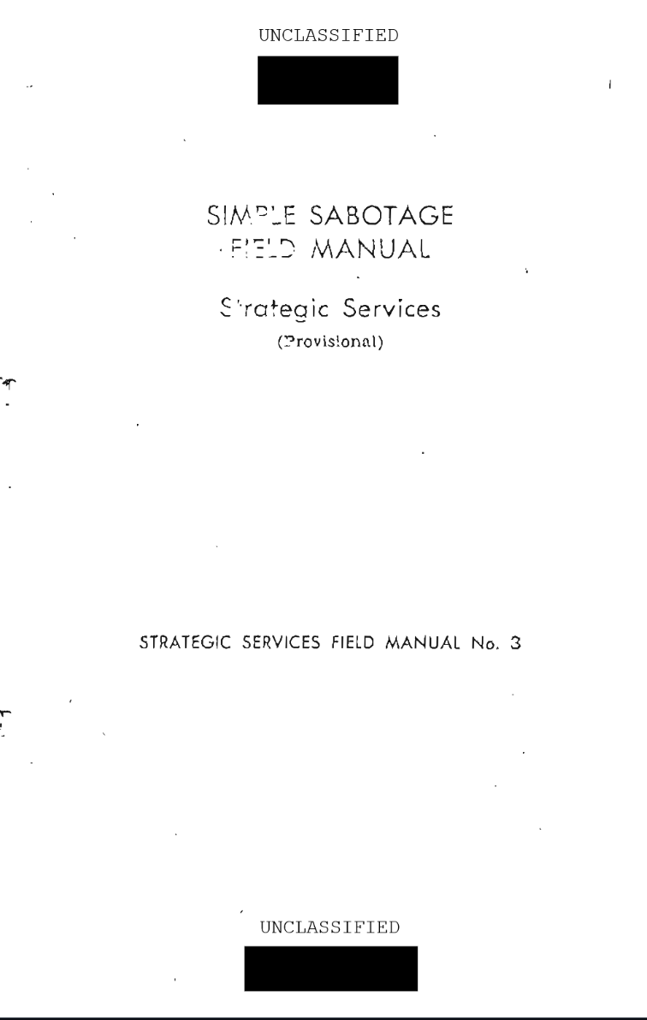
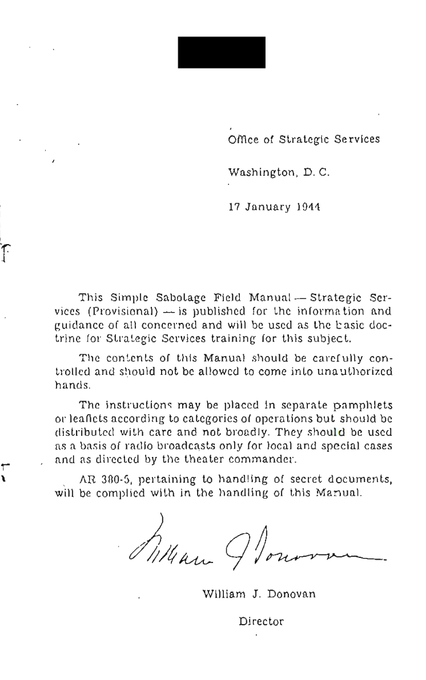
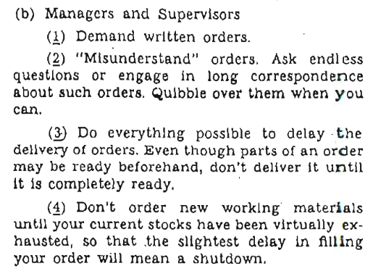



Slide 34
// FIELD MANUAL vs. FIELD OFFICE
1944 said it. 2026 lives it.
OSS, SECTION 11 — 1944
YOUR COMPANY — THIS MORNING
“Insist on doing everything through ‘channels.’ Never permit short-cuts to be taken in order to expedite decisions.”
“Please loop in legal, finance, and brand before we proceed.”
“Refer all matters to committees, for ‘further study and consideration.’ Attempt to make the committee as large as possible — never less than five.”
“Let’s set up a working group to align on the framework.”
“Haggle over precise wordings of communications, minutes, resolutions.”
“Can we wordsmith this in the doc before it goes out?”
“Advocate ‘caution.’ Urge fellow conferees to avoid haste which might result in embarrassments or difficulties later on.”
“I just want to make sure we’ve thought through all the edge cases.”
// “SABOTAGE” THEN… “PROCESS” NOW.

Slide 35
What Happens When You Email "reset my password"
Auto-reply: "Thank you for your request. It has been escalated."
Calendar invite sent: "Password Reset Feasibility Kickoff"
Approval workflow triggered — requires 3 signatures and a notary
Follow-up email: "Per my last email, please advise on your advising."
Jira ticket created: Priority: Critical. Assignee: Nobody.
Password still not reset. Meeting rescheduled for Q3.

Slide 36
IT Bureaucracy Machine
You wanted to reset a password? Bold. Let's schedule some meetings.

Slide 37
The Patterns Are Identical
For Good
Schedule trigger fires
HTTP polls public APIs
IF filters signal from noise
LLM writes the message
Action node delivers it
Result: community is safer
For Chaos
Schedule trigger fires
HTTP polls GitHub API
IF filters repos by victim
LLM writes the snark
Action node files the issue
Result: someone's afternoon is ruined

Slide 38
Try This At Home
Grab the repo: github.com/donnietaylor/automation_for_good_and_chaos
Good starter ideas:
Set up a risk radar for your city — NWS API is free, no key needed
Wire up a daily handoff summary for your team — 30 min to build
Chaos starter ideas:
Point the Snark Bot at a coworker's public repos
Run the Bureaucracy Machine on yourself — it's humbling

